Slide 1
REST APIs
IN712 Web 3

Slide 2
Recap
REST (Representational State Transfer) has become the preferred method for creating Web services
It is simpler than SOAP
Big web service providers (Yahoo, Google, Facebook, Twitter) have all deprecated SOAP and use REST

Slide 3
Motivation for REST
Imagine that you are working for a company that asks you to create an online store for their products to be accessed using a desktop browser
The company hires a new engineering manager that redesigns the web app engine using a new more modern framework due to security concerns around the old framework
You are asked to re-factor the code to accommodate the new framework
A few months later, the online store is very successful but customers complain about the lack of smart phone support
You are asked to create an android app of the online store
Months later, you are asked to create an iPhone app of the online store
Imagine all the work that you will have to invest in learning about the databases interfacing tools and technologies for the different platforms
REST APIs help you solve this problem

Slide 4
REST fundamentals
Rest defines a set of architectural principles by which you can design Web services
Use HTTP methods explicitly
Be stateless
Expose directory structure-like URIs
Transfer data using JSON, XML or both
Strict following the previous principles will make your web service platform/programming language/framework independent

Slide 5
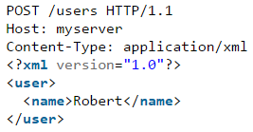
1. Use HTTP methods explicitly
REST explicitly uses HTTP methods in a way that follows the protocol specifications
This basic REST design principle establishes a one-to-one mapping between create, read, update, and delete (CRUD) operations and HTTP methods
To create a resource on the server, use POST
To retrieve a resource from the server, use GET
To update or change the state of a resource, use PUT
To remove a resource, use DELETE
RESTful (Good)
Not RESTful (Bad)

Slide 6

A word about GET and Idempotence
Using GET or HEAD on a resource URL, should NEVER change the resource representation
An idempotent HTTP method is a HTTP method that can be called many times without different outcomes.
It would not matter if the method is called only once, or ten times over. The result should be the same.
Bad!!!!
HTTP Method | Idempotent
OPTIONS | yes
GET | yes
HEAD | yes
PUT | yes
POST | no
DELETE | yes
PATCH | A PATCH request can be idempotent, but it isn't required to be
Notes:
PATCH methods serves to update partial resources. For instance, when you only need to update one field of the resource, PUTting a complete resource representation might be cumbersome and utilizes more bandwidth

Slide 7
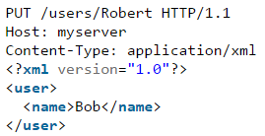
Which of the following 2 HTTP requests is RESTful assuming you want to update information about an existing user in your web application?

Slide 8
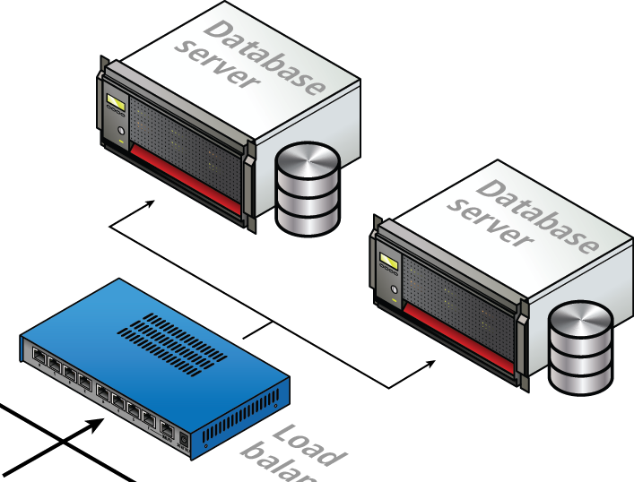
2. Be stateless
REST Web services need to scale to meet increasingly high performance demands
Load balancers and failover capabilities need to be able to forward requests from one server to another
Therefore, RESTful web services clients need to send complete and independent requests, containing all data needed to fulfil the request
A complete, an independent request does not require the server, while processing the requests, to retrieve any kind of application context or state
A RESTful web service application includes within the headers and body of a request all of the parameters, context and data needed by the server to generate a response
Statelessness or the absence of state on the server removes the need to synchronize session data with an external application

Slide 9
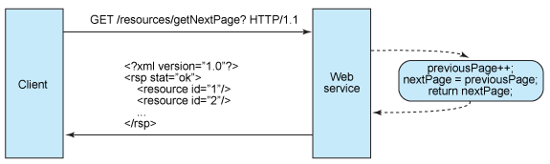
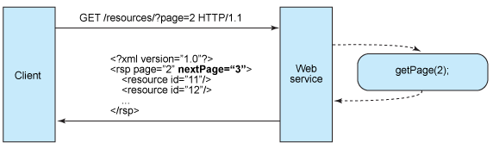
2. Be stateless
An application requests the next page in a multipage result set:
Stateful design. Not RESTul (Bad)
Stateless design. RESTul (Good)

Slide 10
2. Be stateless
Stateless server-side components are less complicated to design, write and distribute across load balanced servers
A stateless web service shifts the responsibility of maintaining state to the client
In a RESTful web service, the server is responsible for generating responses and for providing an interface that enables the client to maintain application state on its own
Server
Generates responses that include links to other resources to allow applications to navigate between related resources.
Generates responses that indicate whether they are cacheable or not to improve performance by reducing the number of requests for duplicate resources and by eliminating some requests entirely.
The server does this by including a Cache-Control and Last-Modified (a date value) HTTP response header
Client Application
Uses the Cache-Control response header to determine whether to cache the resource (make a local copy of it) or not.
The client also reads the Last-Modified response header and sends back the date value in an If-Modified-Since header to ask the server if the resource has changed. This is called Conditional GET
Client sends complete requests that can be serviced independently of other requests. The client sends complete representations of resources in the request body. The client sends requests that make very few assumptions about prior requests.

Slide 11
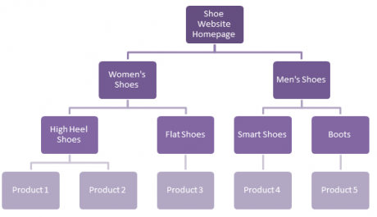
3. Expose directory structure-like URIs
The URIs determine how intuitive the REST Web service is going to be
A URI should be a self-documenting interface that requires little, if any, explanation or reference for a developer to understand what it points to and to derive related resources.
One way to achieve this level of usability is to define directory structure-like URIs.
This type of URI is hierarchical, rooted at a single path, and branching from it are subpaths that expose the service's main areas.
www.ashoewebsite.com
www.ashoewebsite.com/womens-shoes
www.ashoewebsite.com/womens-shoes/high-heels
www.ashoewebsite.com/womens-shoes/high-heels/product-1
www.ashoewebsite.com/mens-shoes
www.ashoewebsite.com/mens-shoes/boots
www.ashoewebsite.com/mens-shoes/boots/product-5
Uninformative, unstructured URI. Not RESTul
http://www.mybookstore.com/XSD34SSFGGHSXF4
Informative, structured URI. RESTul
http://www.mybookstore.com/users/userName/orders/1

Slide 12
3. Expose directory structure-like URIs
Additional guidelines for RESTful URIs structure
Hide server-side scripting technology file extensions (.jsp, .php, .asp)
That way you can port to something else without changing the URIs.
Keep everything lowercase
Substitute spaces with hyphens or underscores (one or the other).
Avoid query strings as much as you can
Instead of using the 404 Not Found code if the request URI is for a partial path, always provide a default page or resource as a response
Question! Is the following URI RESTful?
http://www.myforum.com/year/month/day/topic

Slide 13
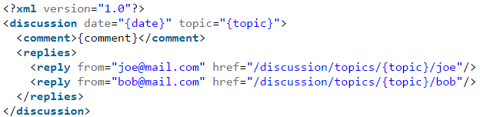
4. Transfer data using JSON, XML or both
A resource representation typically reflects the current state of a resource, and its attributes, at the time a client application requests it.
The objects in your data model are usually related in some way, and the relationships between data model objects (resources) should be reflected in the way they are represented for transfer to a client application.

Slide 14
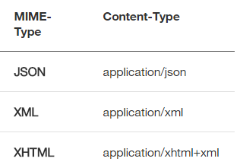
4. Transfer data using JSON, XML or both
Give client applications the ability to request a specific content type that's best suited for them
Construct your service so that it makes use of the built-in HTTP Accept header, where the value of the header is a MIME type.
This allows the service to be used by a variety of clients written in different languages running on different platforms and devices.
Using MIME types and the HTTP Accept header is a mechanism known as content negotiation, which lets clients choose which data format is right for them and minimizes data coupling between the service and the applications that use it
https://en.wikipedia.org/w/api.php?action=query&titles=Main%20Page&prop=revisions&rvprop=content&format=json
https://en.wikipedia.org/w/api.php?action=query&titles=Main%20Page&prop=revisions&rvprop=content&format=xml

Slide 15
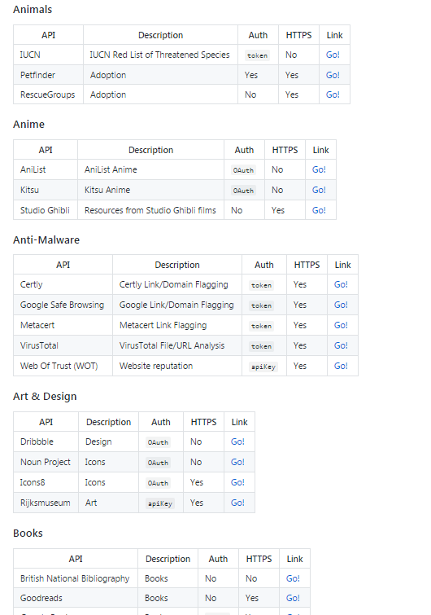
A list of free APIs for use in web development
https://github.com/toddmotto/public-apis

